Slide 1
Why we need multiple web archives:
The case of blog.reidreport.com
2019-02-13
Puneeth Bikkasandra
Old Dominion University

Slide 2
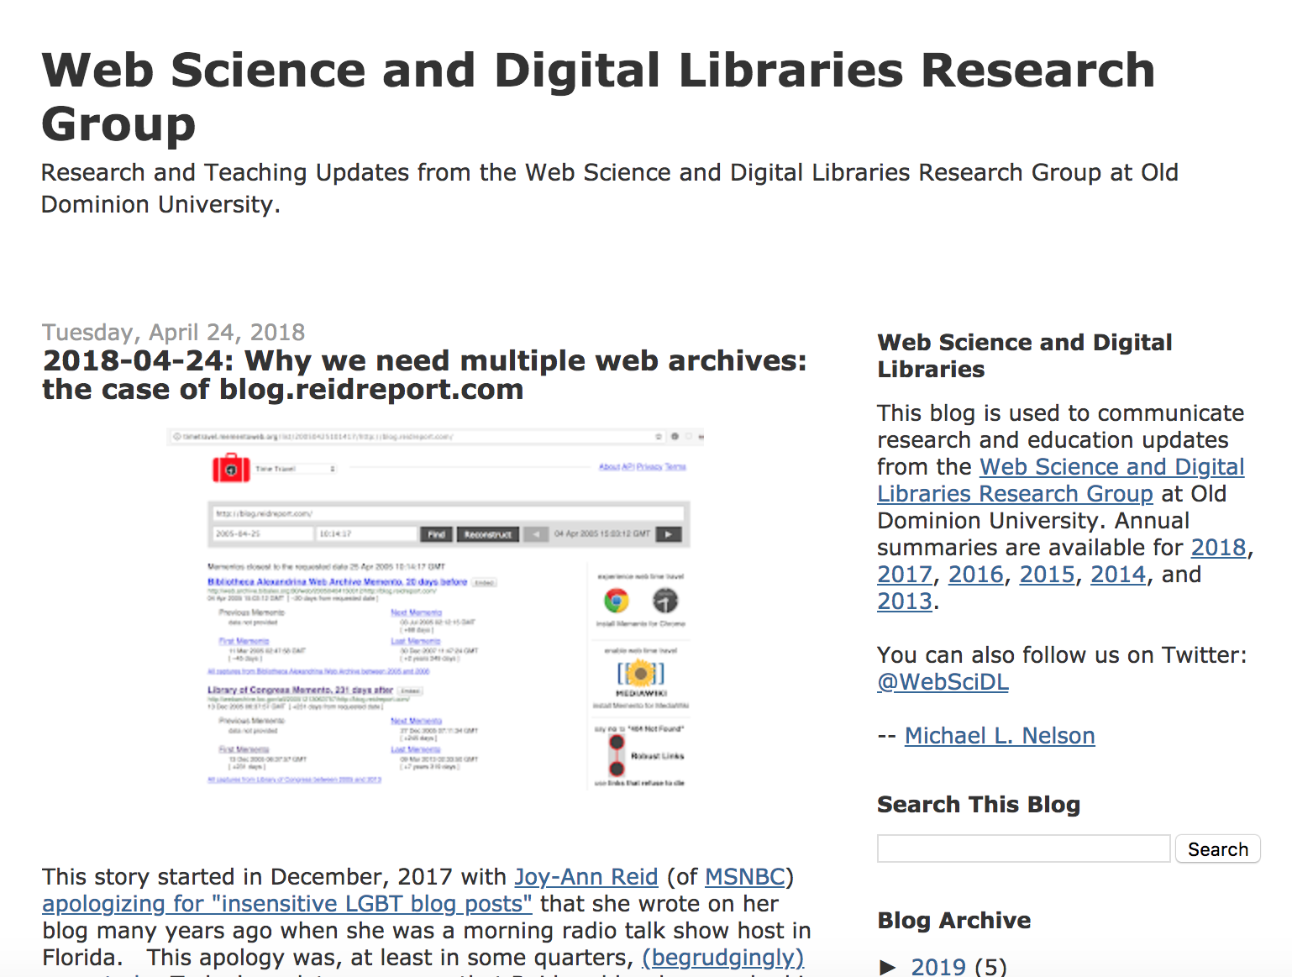
Slides are based on ws-dl blog
https://ws-dl.blogspot.com/2018/04/2018-04-24-why-we-need-multiple-web.html

Slide 3

Dr. Nelson on CNN interview
https://www.cnn.com/videos/tv/2018/04/28/msnbc-host-reid-hack-victim-or-homophobe.cnn

Slide 4
Why do we need archiving?
Web archives, record the entire contents of a web page, including its source HTML and embedded images, stylesheets, or JavaScript source
Upon playback, the user can interact with the archived page, including clicking links to explore what the web page was connected to
Web archives have been used as evidence in court cases and in the court of public opinion—often to hold politicians and governments accountable for things they have said in the past
Also, evidence to make informed decisions in Personal, Political, Business and Policy, etc.
https://parameters.ssrc.org/2018/09/on-the-importance-of-web-archiving/

Slide 5
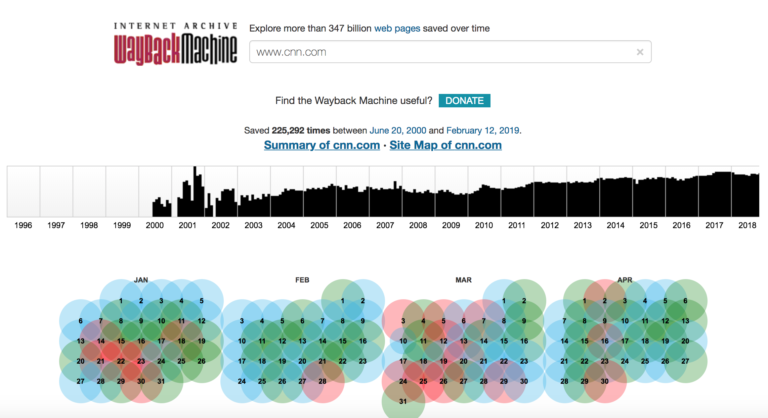
CNN.com mementos on Wayback Machine.

Slide 6
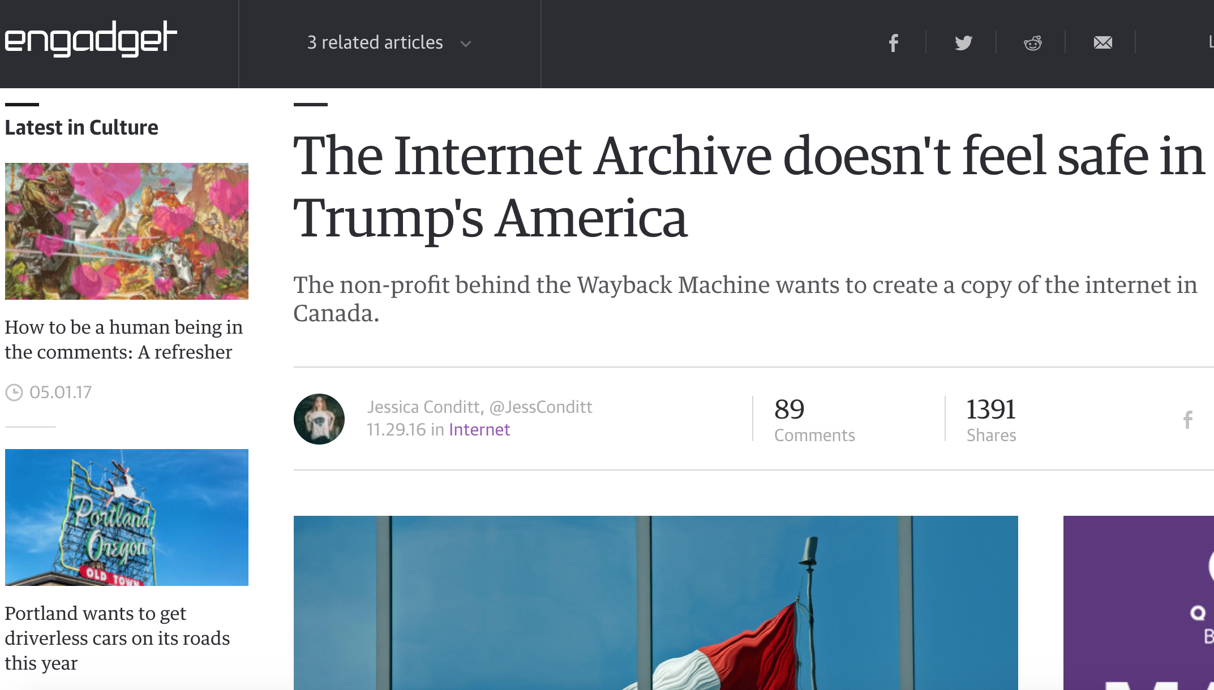
Archives are not so safe...
https://www.engadget.com/2016/11/29/the-internet-archive-doesnt-feel-safe-in-trumps-america/

Slide 7
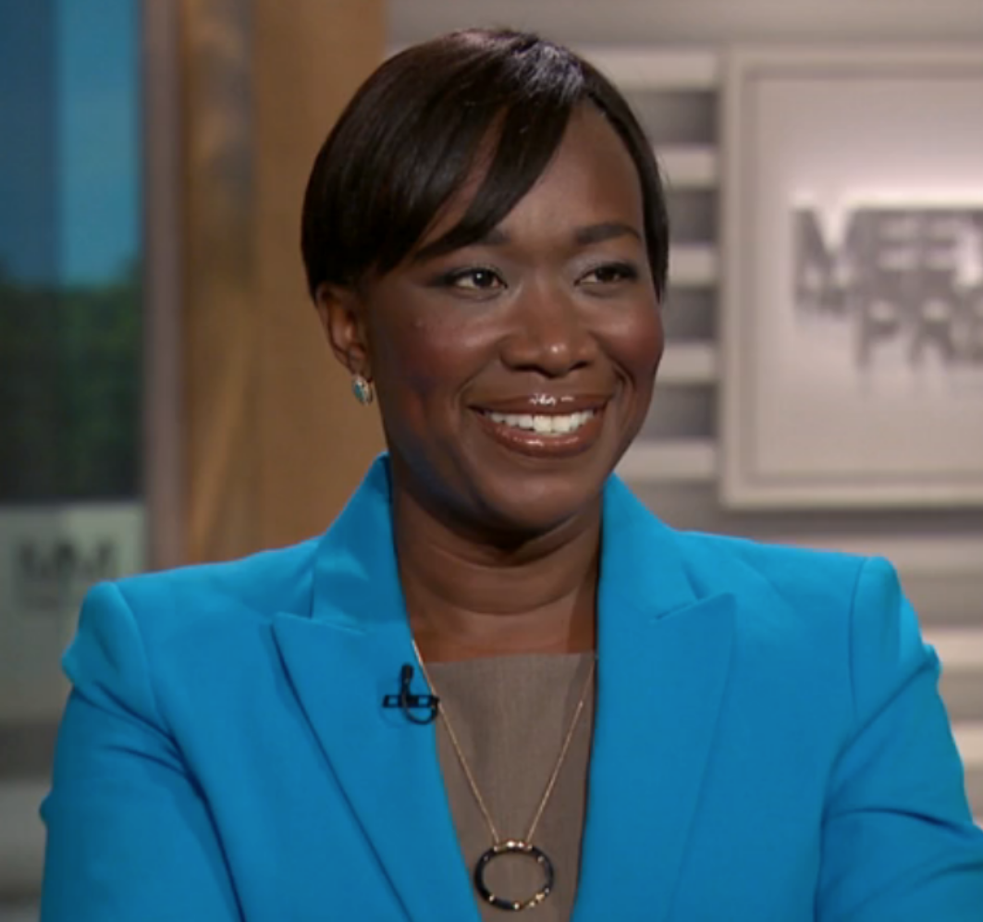
Curious case of ‘Joy Ann Reid’
American cable television-host, national correspondent @MSNBC
Co-host of Wake Up South Florida, a morning radio talk show broadcast from Radio One and The Reid Report
Political Party: Democratic.
Author: blog.reidreport.com
An Avid Blogger!!!
https://en.wikipedia.org/wiki/Joy_Reid

Slide 8
Joy Reid Saga:
Active on blog.reidreport.com since 2005
Made series of homophobic comments on Former Florida Governor Charlie Crist and athlete Tim Hardaway
Later, decided to take down the blog posts to hide the consequences
12/2017 - Approach Internet Archive: complaining the blog/archive records for being hacked
12/2017 - Apologized for the posts.
@Jamie_Maz tweets motivated further research
Atleast 5 blog pages were found in the archives of “Library of Congress”
https://ws-dl.blogspot.com/2018/04/2018-04-24-why-we-need-multiple-web.html

Slide 9
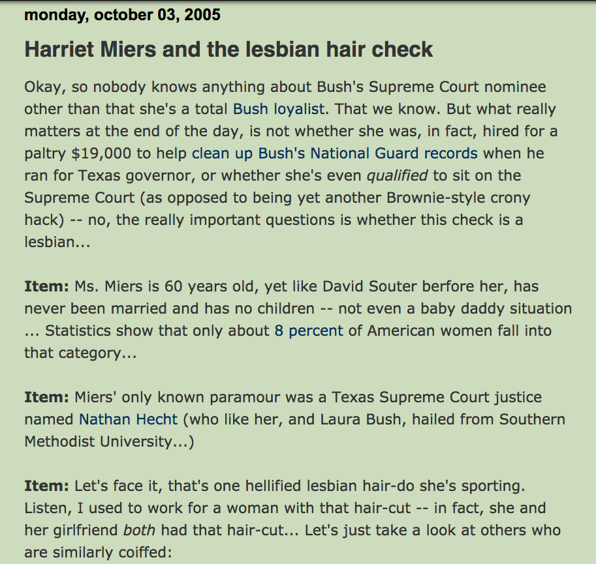
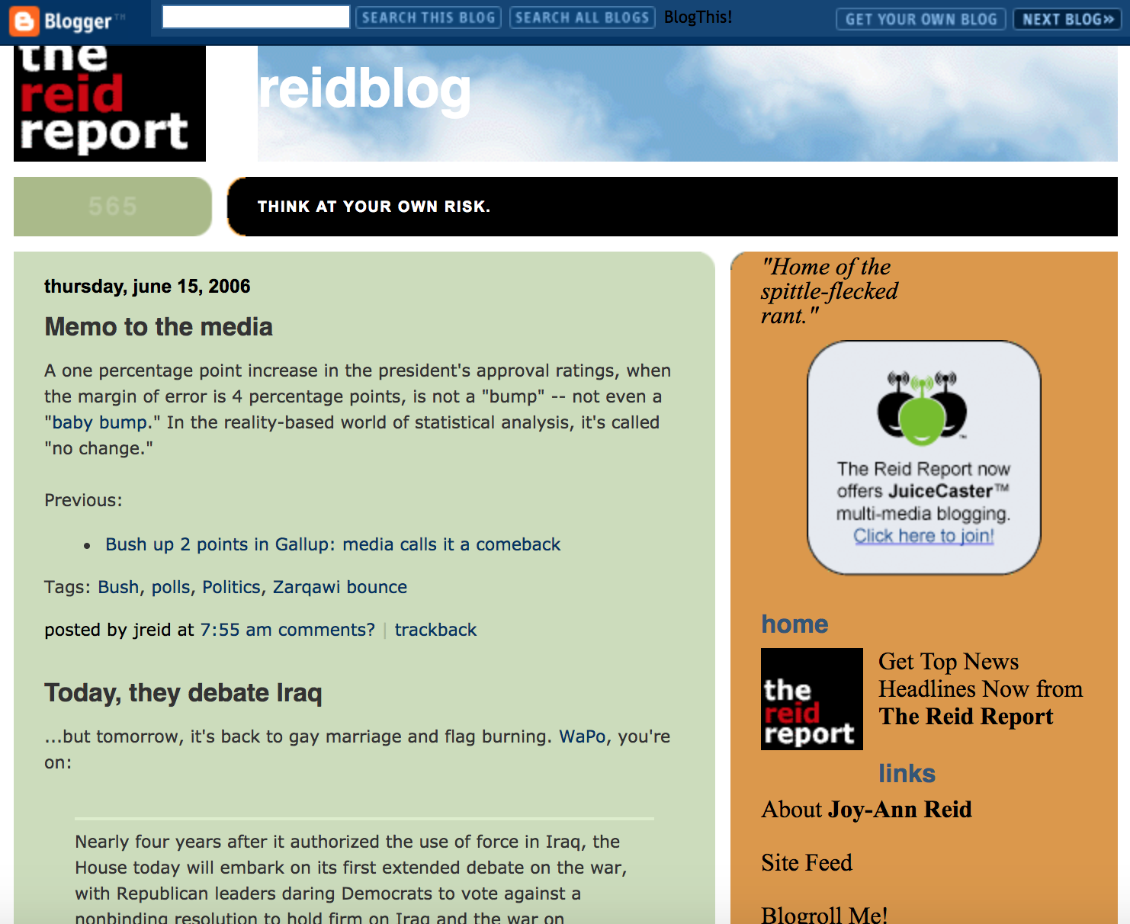
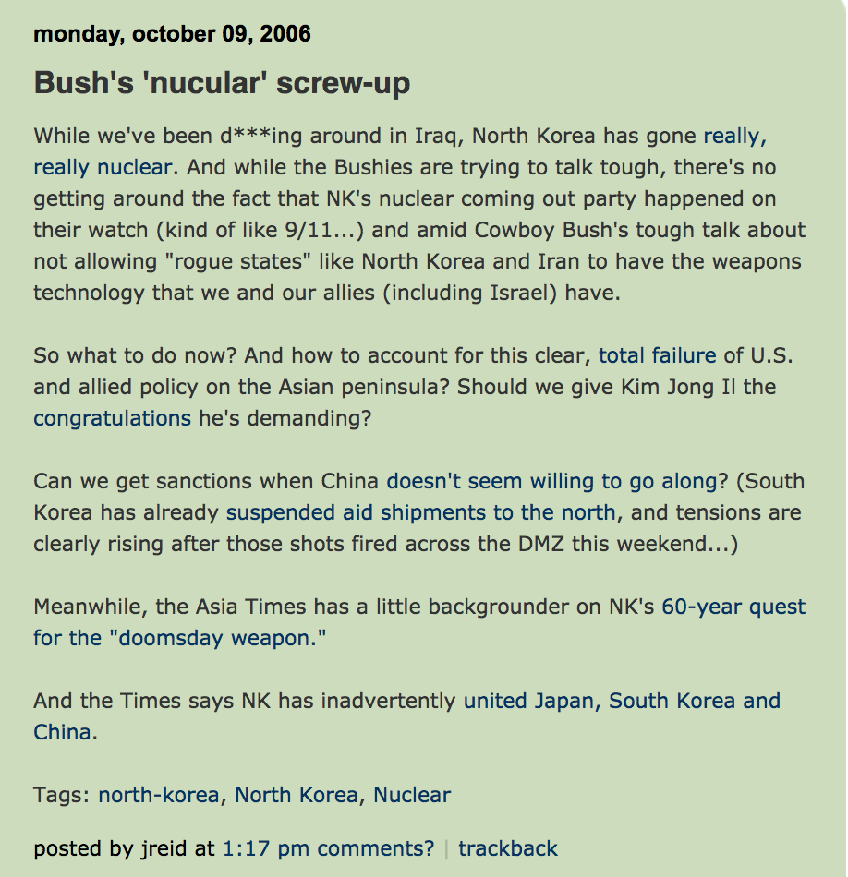
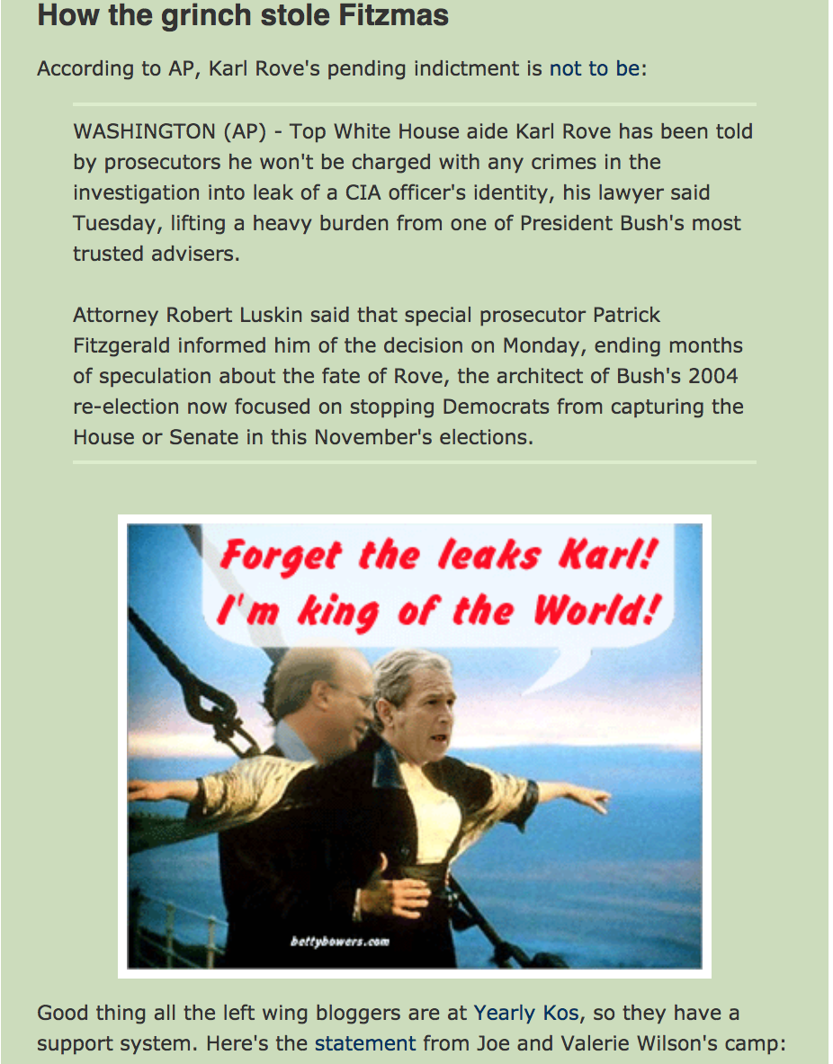
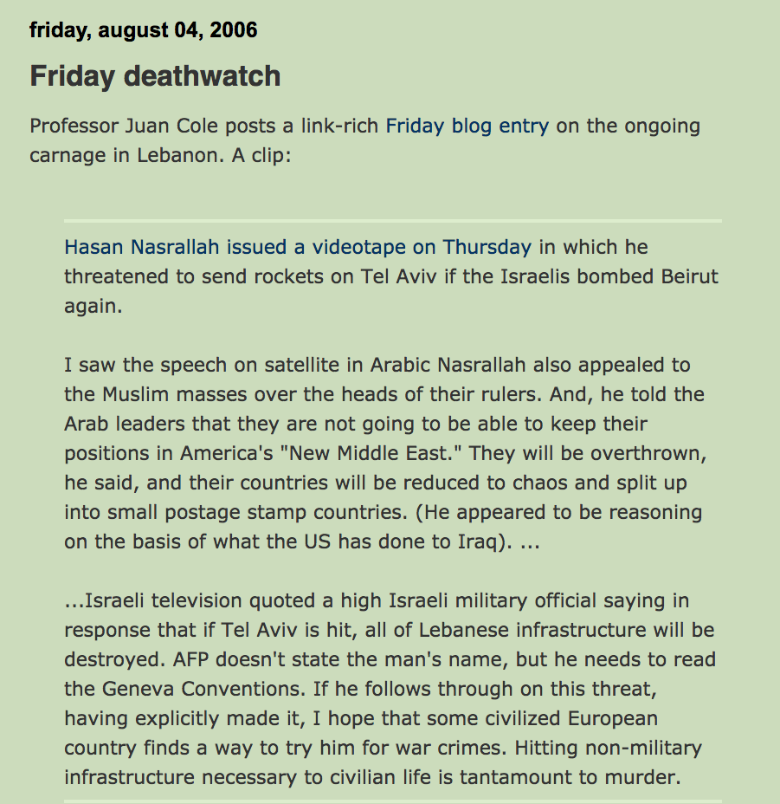
Authored series of blog articles...
https://ws-dl.blogspot.com/2018/04/2018-04-24-why-we-need-multiple-web.html

Slide 10
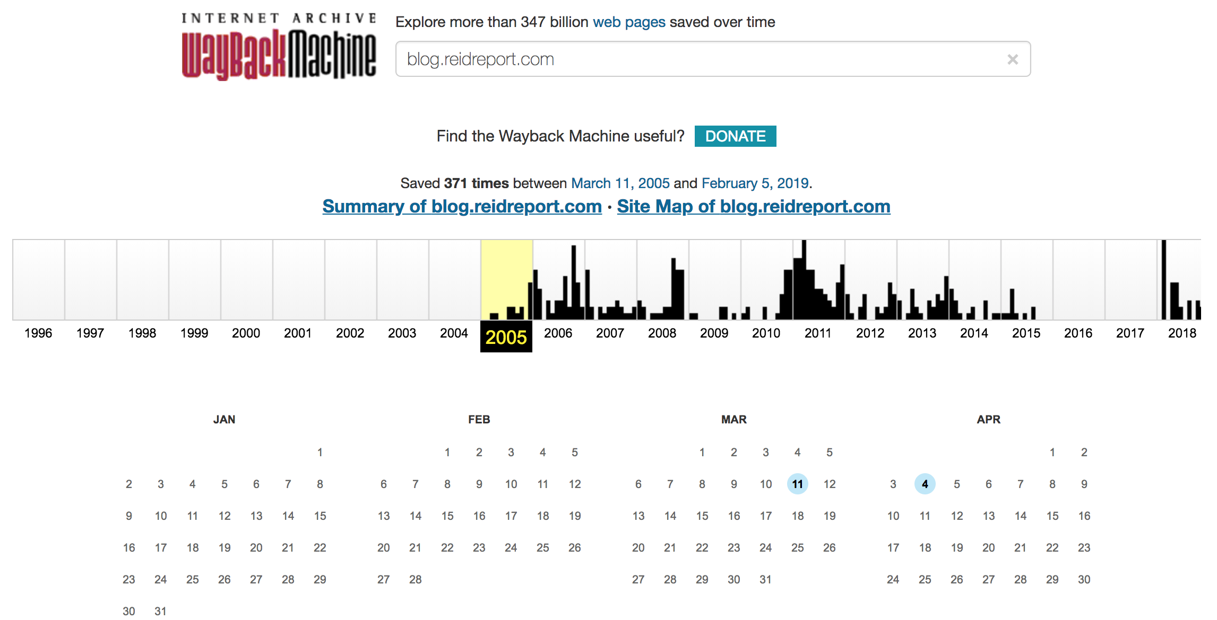
First memento @Internet Archive - 2005/03/11 & 13 mementos.

Slide 11
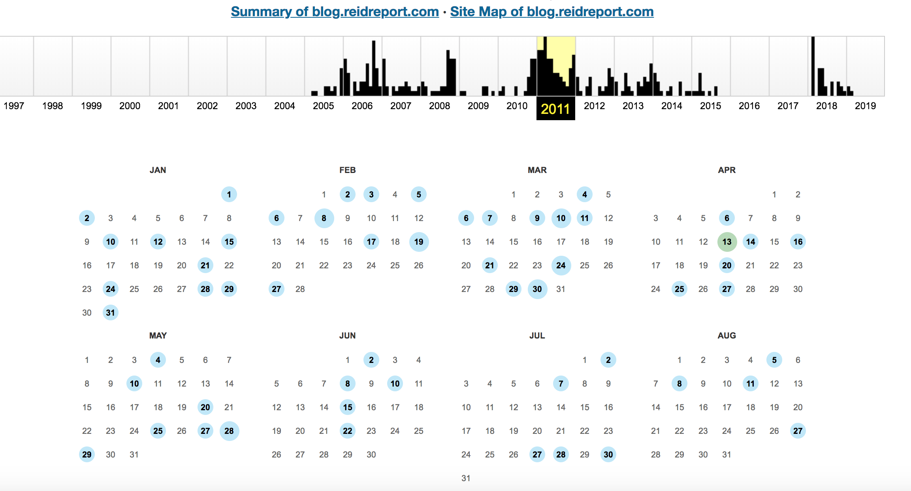
Approximately 100 mementos during 2011!

Slide 12
Reid complains about hacking!
Lawyers contact Internet Archive asking to take down archived records
Reason - insertion of fraudulent posts into legitimate content.
Not sure about hacking if it was on a live site or on archives.
Later, IA crawler “ia_archiver” was excluded from indexing
blog.reidreport.com
https://ws-dl.blogspot.com/2018/04/2018-04-24-why-we-need-multiple-web.html
http://blog.archive.org/2018/04/24/addressing-recent-claims-of-manipulated-blog-posts-in-the-wayback-machine/

Slide 13
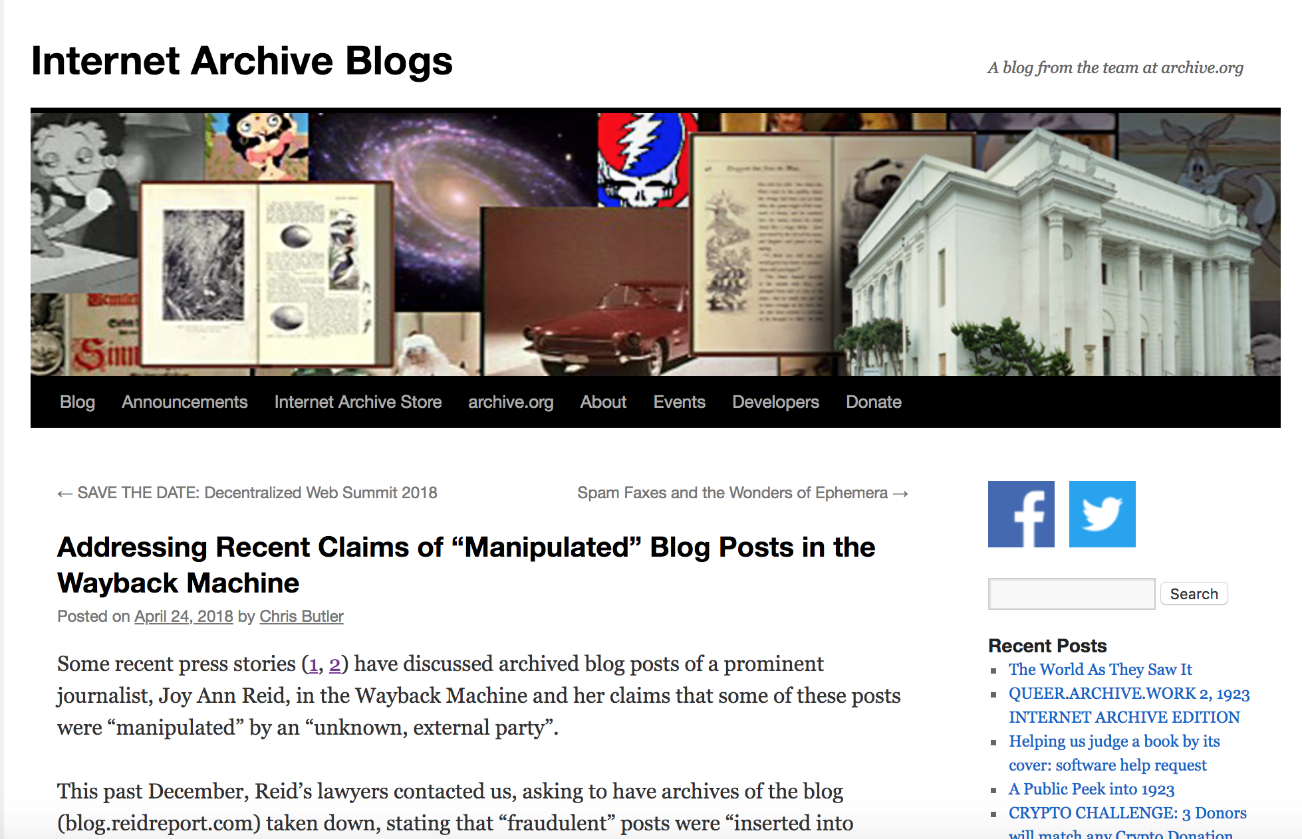
Internet archive denies the hacking and keeps blog’s record active!!!
http://blog.archive.org/2018/04/24/addressing-recent-claims-of-manipulated-blog-posts-in-the-wayback-machine/

Slide 14
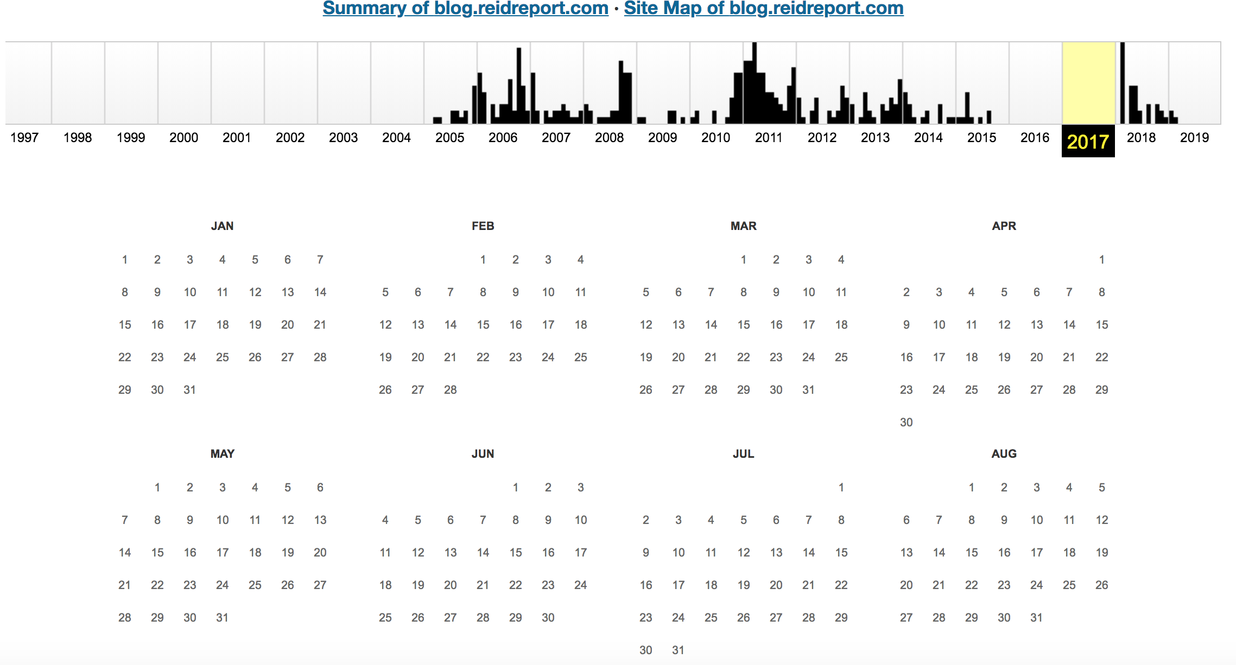
No records were archived due to robots.txt exclusion

Slide 15
What is robots.txt?
Robots Exclusion Protocol:
web site owners use the /robots.txt file to give instructions about their site to web robots
a robot wants to visit a website: http://www.example.com/welcome.html
checks for http://www.example.com/robots.txt and finds the below command:
User-agent: *
Disallow: /
meaning that this section applies to all robots and not to visit any pages on the site.
http://www.robotstxt.org/robotstxt.html

Slide 16
robots.txt continued...
Its is publicly available and can be ignored (especially by malware robots)
blog.reidreport.com/robots.txt had below command:
User-agent: ia_archiver
Disallow: /
citing this command, Internet Archive crawler was excluded from parsing the content.
http://blog.archive.org/2018/04/24/addressing-recent-claims-of-manipulated-blog-posts-in-the-wayback-machine/

Slide 17
Exclusion of IA through robots.txt...
robots.txt exclusion on live blog, preventing “ia_archiver”, a crawler from
Internet Archive
So no more archiving of “blog.reidreport.com”!
Levels of exclusion on robots.txt:
02/16/2018 - blocked admin section of wordpress
02/21/2018 - blocked all the robots.
04/24/2018 - blocking only “ia_archiver”!
https://ws-dl.blogspot.com/2018/04/2018-04-24-why-we-need-multiple-web.html

Slide 18
Hostnames are not same!
nslookup www.blog.reidreport.com
Server: 128.82.254.154
Address: 128.82.254.154#53
Non-authoritative answer:
Name: www.blog.reidreport.com
Address: 216.239.38.21
Name: www.blog.reidreport.com
Address: 216.239.34.21
Name: www.blog.reidreport.com
Address: 216.239.36.21
Name: www.blog.reidreport.com
Address: 216.239.32.21
nslookup blog.reidreport.com
Server: 128.82.254.154
Address: 128.82.254.154#53
Non-authoritative answer:
Name: blog.reidreport.com
Address: 66.147.240.182

Slide 19
www.blog.reidreport.com (vs) blog.reidreport.com
curl -i https://www.blog.reidreport.com/robots.txt
HTTP/1.1 200 OK
X-Robots-Tag: noindex, nofollow
Content-Type: text/plain; charset=UTF-8
Expires: Wed, 13 Feb 2019 03:07:11 GMT
Date: Wed, 13 Feb 2019 03:07:11 GMT
Cache-Control: private, max-age=86400
Last-Modified: Sun, 23 Dec 2018 09:59:05 GMT
X-Content-Type-Options: nosniff
X-XSS-Protection: 1; mode=block
Server: GSE
Accept-Ranges: none
Vary: Accept-Encoding
Transfer-Encoding: chunked
User-agent: ia_archiver
Disallow: /
curl -i blog.reidreport.com/robots.txt
HTTP/1.1 404 Not Found
Server: nginx/1.14.1
Date: Wed, 13 Feb 2019 03:10:28 GMT
Content-Type: text/html
Transfer-Encoding: chunked
Connection: keep-alive
Vary: Accept-Encoding
X-Endurance-Cache-Level: 2
https://ws-dl.blogspot.com/2018/04/2018-04-24-why-we-need-multiple-web.html

Slide 20
Does standard URL has robots.txt?
At present the blog is not accessible.
curl -i http://blog.reidreport.com/robots.txt
HTTP/1.1 404 Not Found
Server: nginx/1.14.1
Date: Mon, 11 Feb 2019 12:10:46 GMT
Content-Type: text/html
Transfer-Encoding: chunked
Connection: keep-alive
Vary: Accept-Encoding
X-Endurance-Cache-Level: 2
https://ws-dl.blogspot.com/2018/04/2018-04-24-why-we-need-multiple-web.html

Slide 21
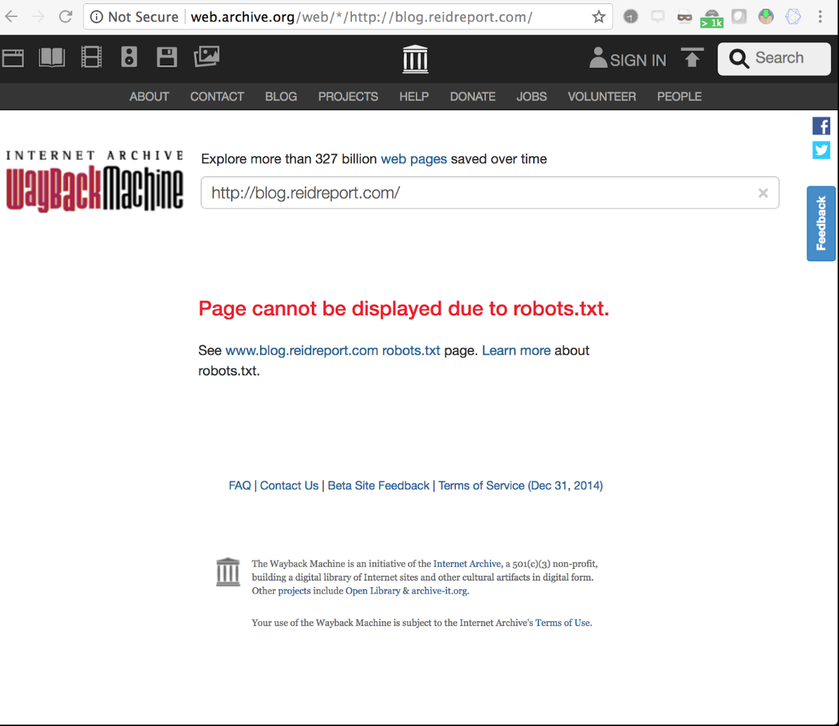
Not Found on Wayback Machine!
Following robots.txt exclusion, blog was blocked from indexing from Internet Archive.
But what if we had multiple
archiving platforms?

Slide 22
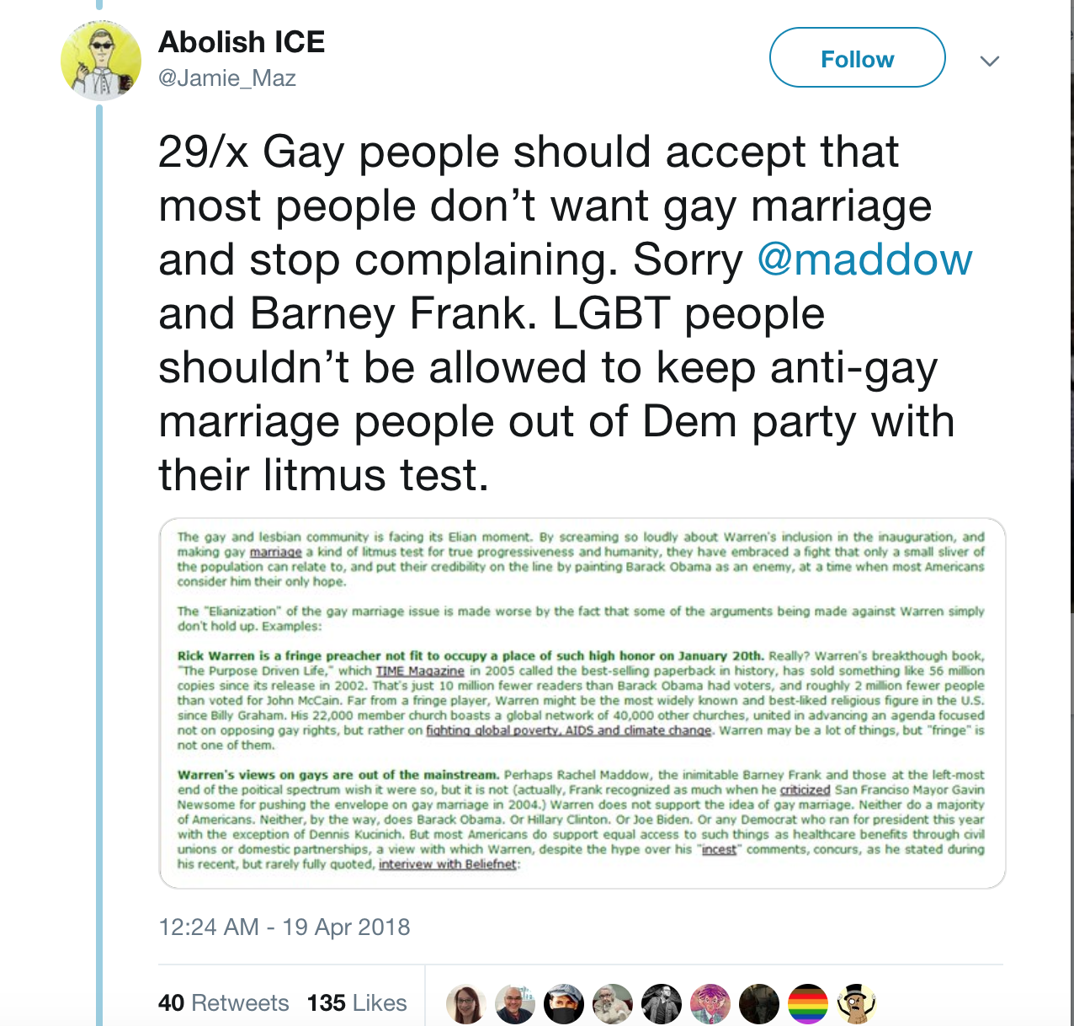
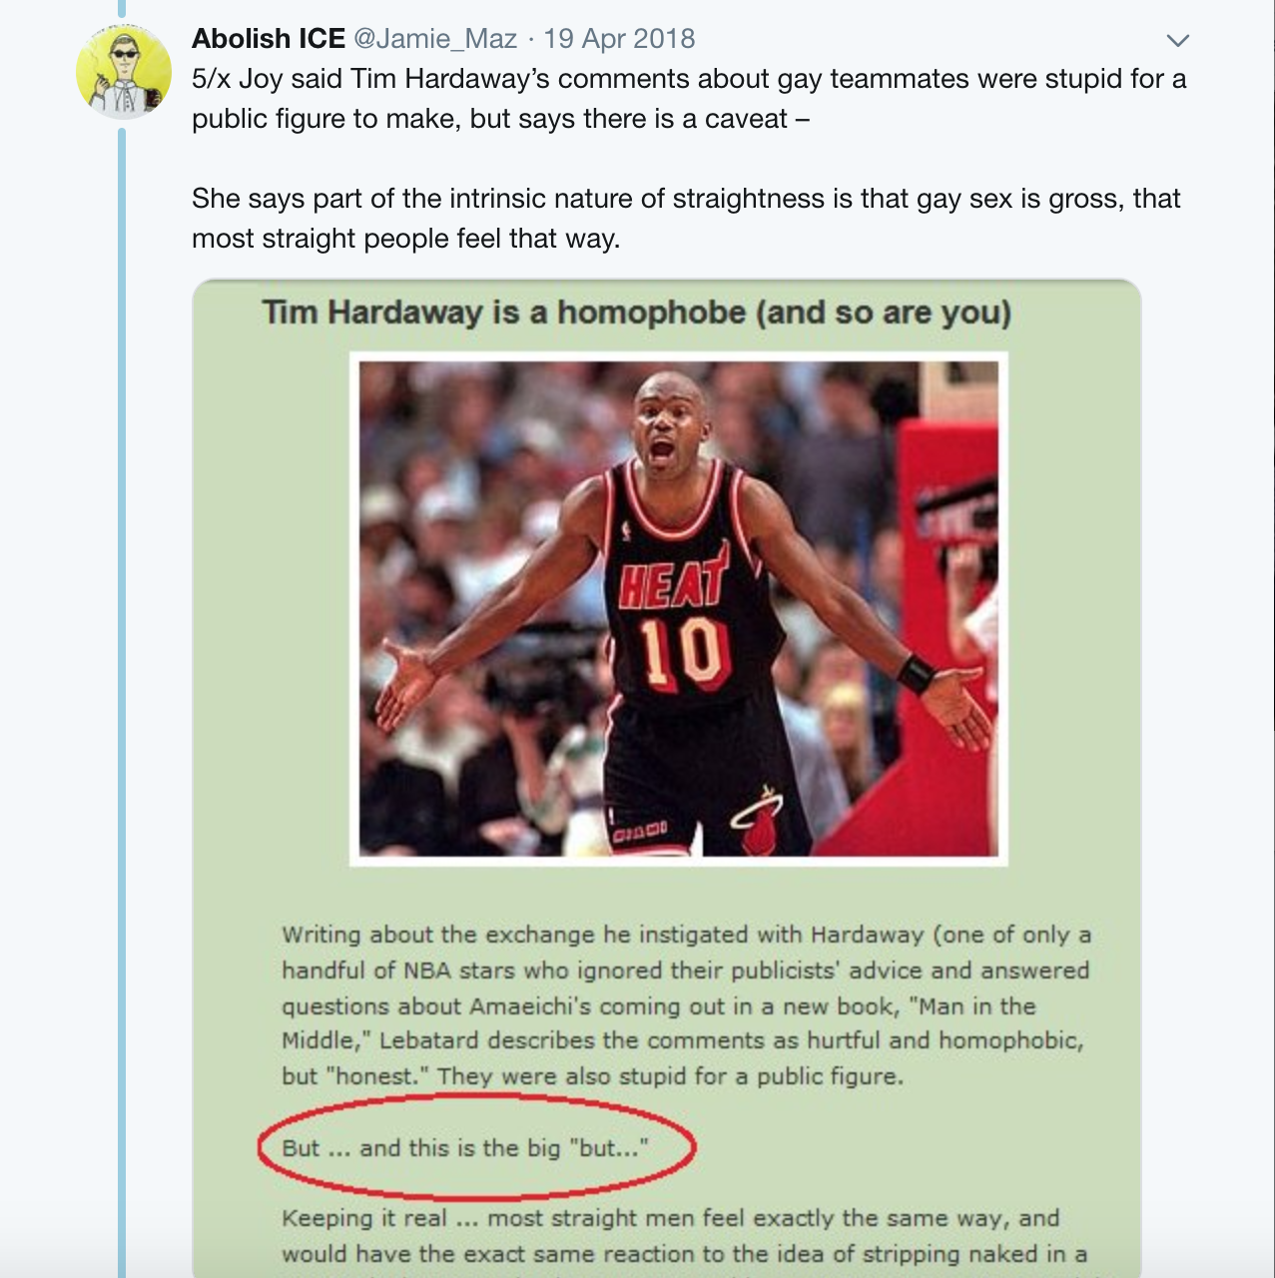
@Jamie_Maz tweets aids in finding original blog on other archive!
https://ws-dl.blogspot.com/2018/04/2018-04-24-why-we-need-multiple-web.html
http://webarchive.loc.gov/all/20060125004941/http://blog.reidreport.com/

Slide 23
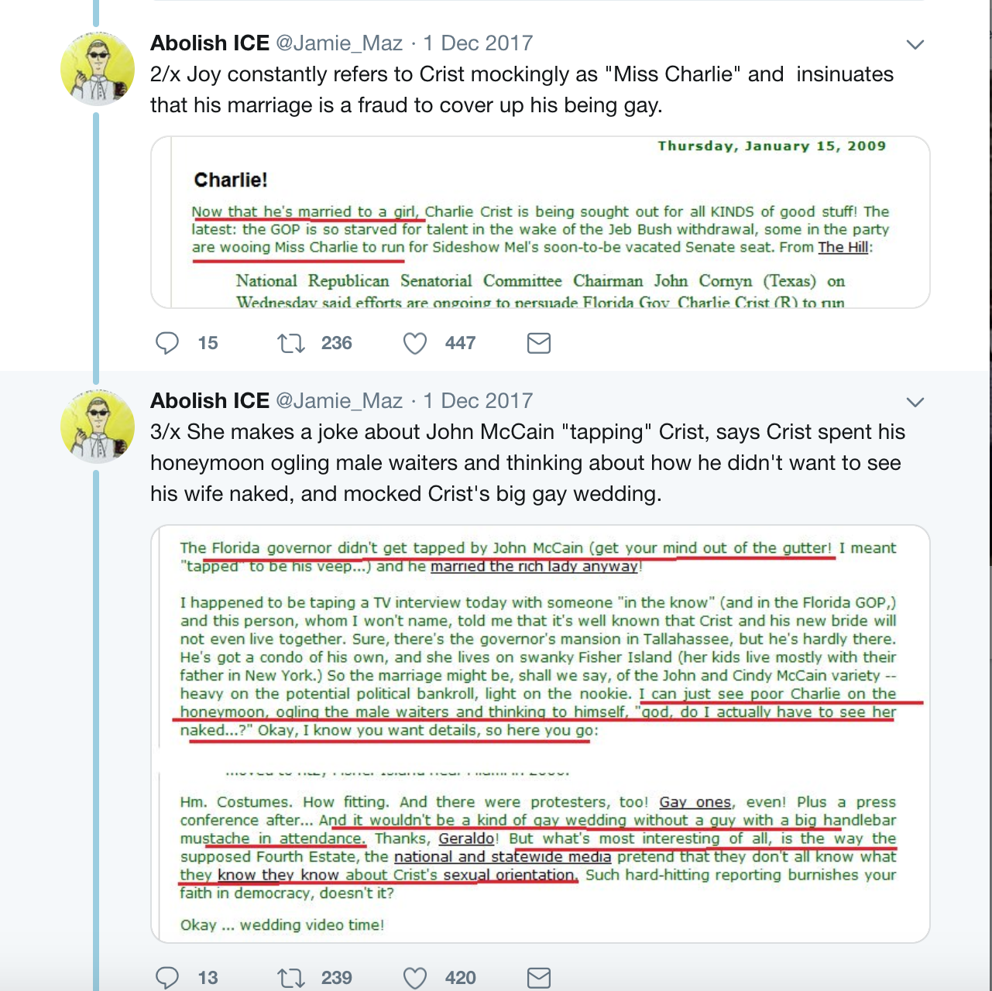
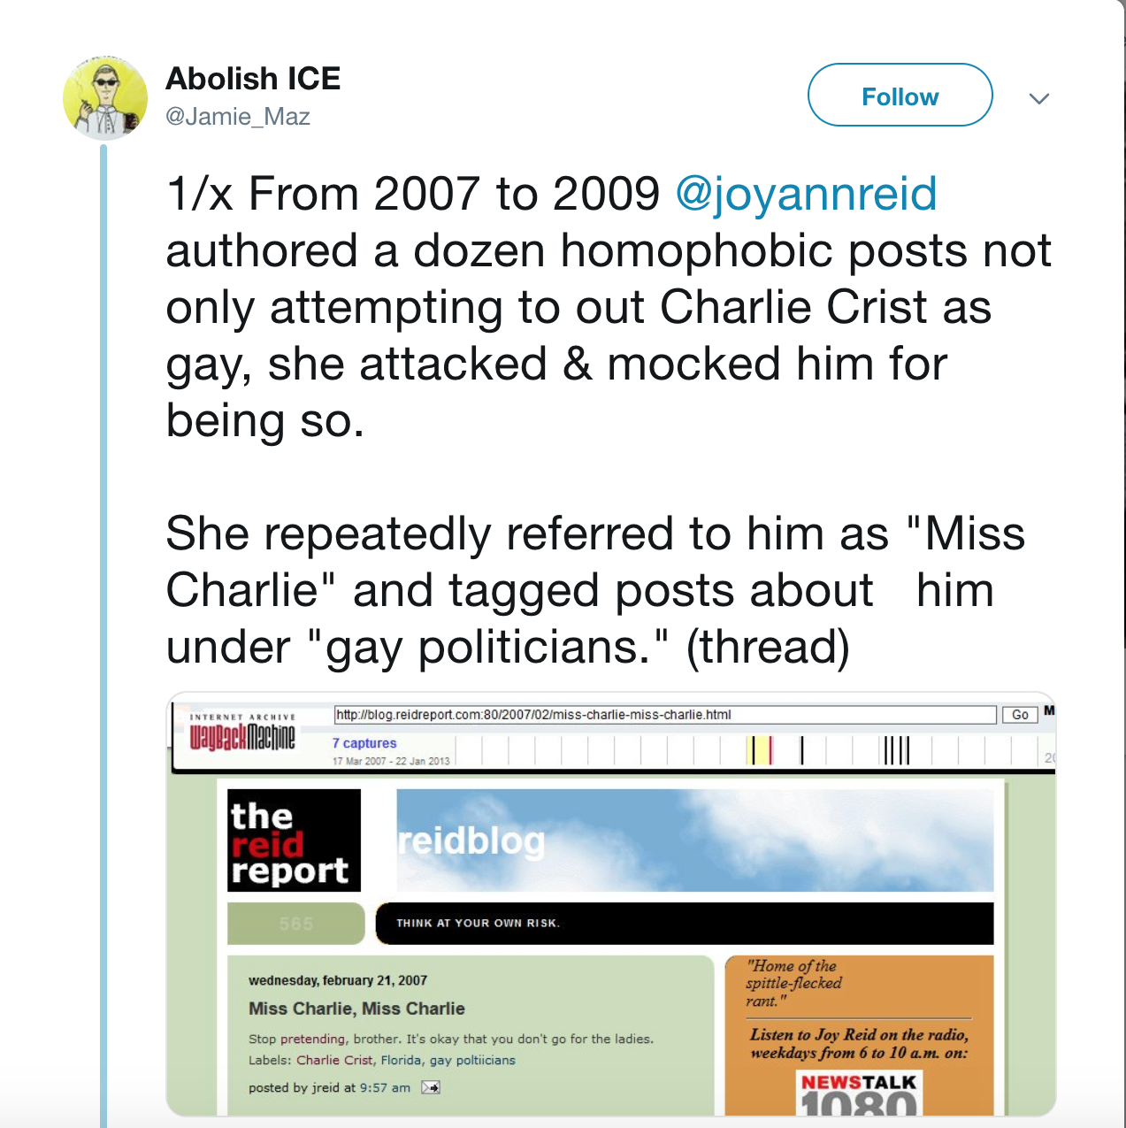
@Jamie_Maz tweets on Reid’s comments
https://ws-dl.blogspot.com/2018/04/2018-04-24-why-we-need-multiple-web.html

Slide 24
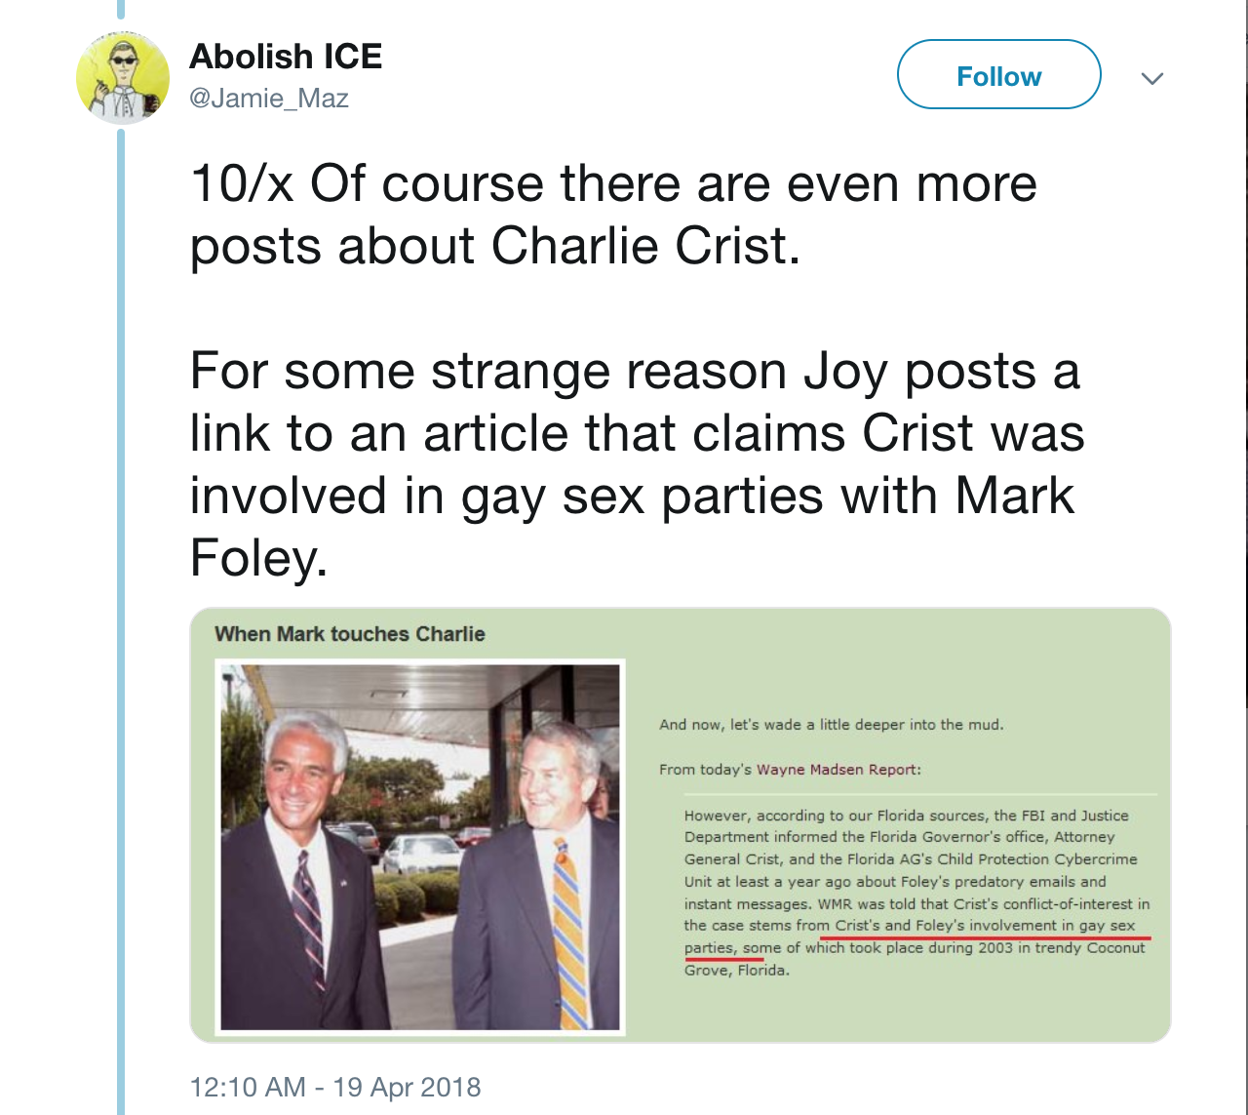
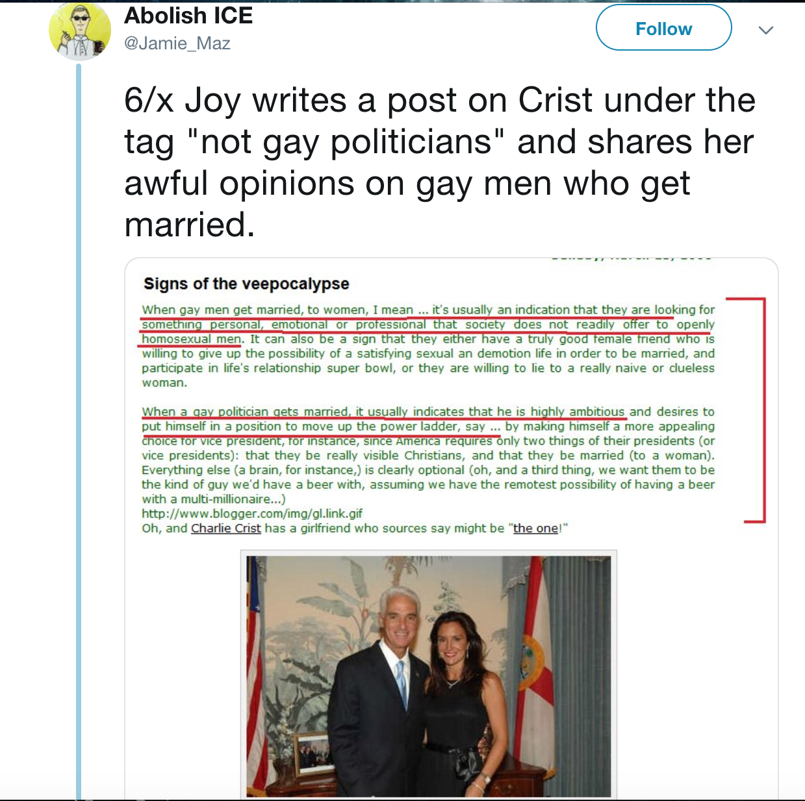
Reid’s comments on Charlie Crist.
http://webarchive.loc.gov/all/20061010125903/http://blog.reidreport.com/

Slide 25
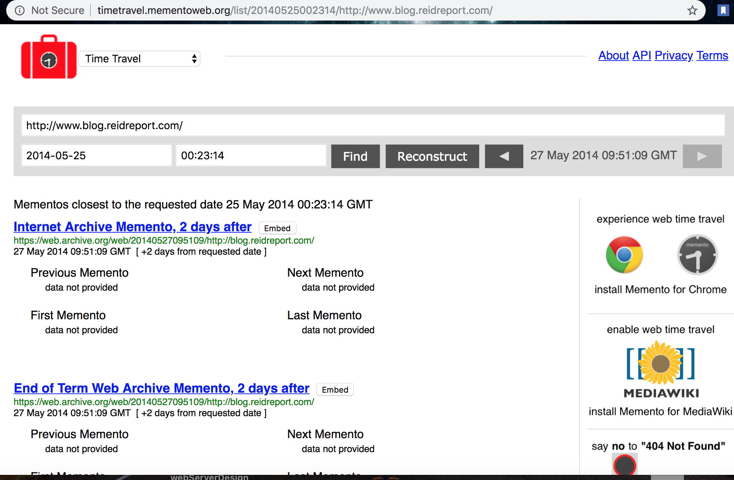
blog.reidport.com is found in 5 different archives..

Slide 26
Blog mementos from different archives
curl --silent http://memgator.cs.odu.edu/timemap/link/http://blog.reidreport.com/ | grep datetime | awk '{print $1}' | awk -v FS=/ '{print $3}' | sort | uniq -c
31 archive.md
75 wayback.archive-it.org
2 wayback.vefsafn.is
371 web.archive.org

Slide 27

Joy Reid: My blog posts are fabricated!
https://www.mediaite.com/online/exclusive-joy-reid-claims-newly-discovered-homophobic-posts-from-her-blog-were-fabricated/

Slide 28
Timestamps from the @Jamie_Maz tweets aided to unearth mementos from other web archives, which were originally crawled by Internet Archive.
It appears that the blog pages are saved in multiple archives, the chances of these archives being hacked is very less.
It can be concluded that the evidence from multiple archives and a corresponding analysis from Internet Archive Engineers, that Reid’s claim of hacking is vague and was made to hide the consequences.
Some Facts:
https://ws-dl.blogspot.com/2018/04/2018-04-24-why-we-need-multiple-web.html

Slide 29
Continued...
Along these lines, there were further claims about blog being hacked and Internet Archive saving the modified blog pages.
But if they claim only few pages are modified, blog.reidreport.com would have been hacked long back and nobody noticed it.
The archived page shows 2006 blog status
6 posts on January 11,
12 posts on January 10 and
11 posts on January 09.
It is clear that Reid interacted with the blog regularly and not noticing it is not acceptable.
https://ws-dl.blogspot.com/2018/04/2018-04-24-why-we-need-multiple-web.html

Slide 30
Technically feasible, but highly unlikely!
Wayback Machine has been archiving posts for years and years, and in many instances, it re-crawls URLs
A blog post that went live in 2006 might have been indexed in 2007 and 2009 and 2011 and 2017
If Reid’s blog was hacked to insert new posts with old dates, Internet Archive’s repository would have recent dates, though blog had old time stamps!
At least 5 archived web pages in the Library of Congress that confirm the claims of @Jamie_Maz.
https://ws-dl.blogspot.com/2018/04/2018-04-24-why-we-need-multiple-web.html
https://www.theatlantic.com/technology/archive/2018/04/the-evidence-is-not-with-joy-reid/558935/

Slide 31
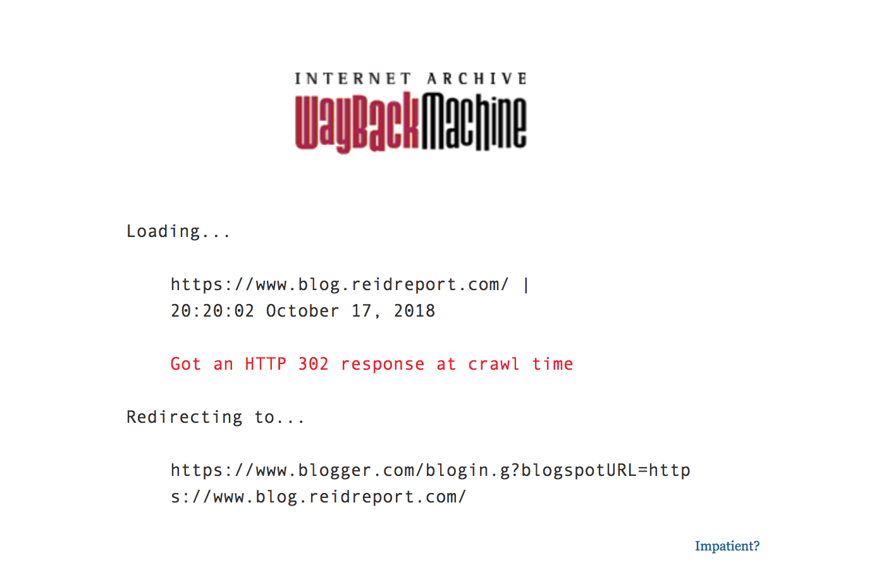
The blog is now not accessible from IA

Slide 32
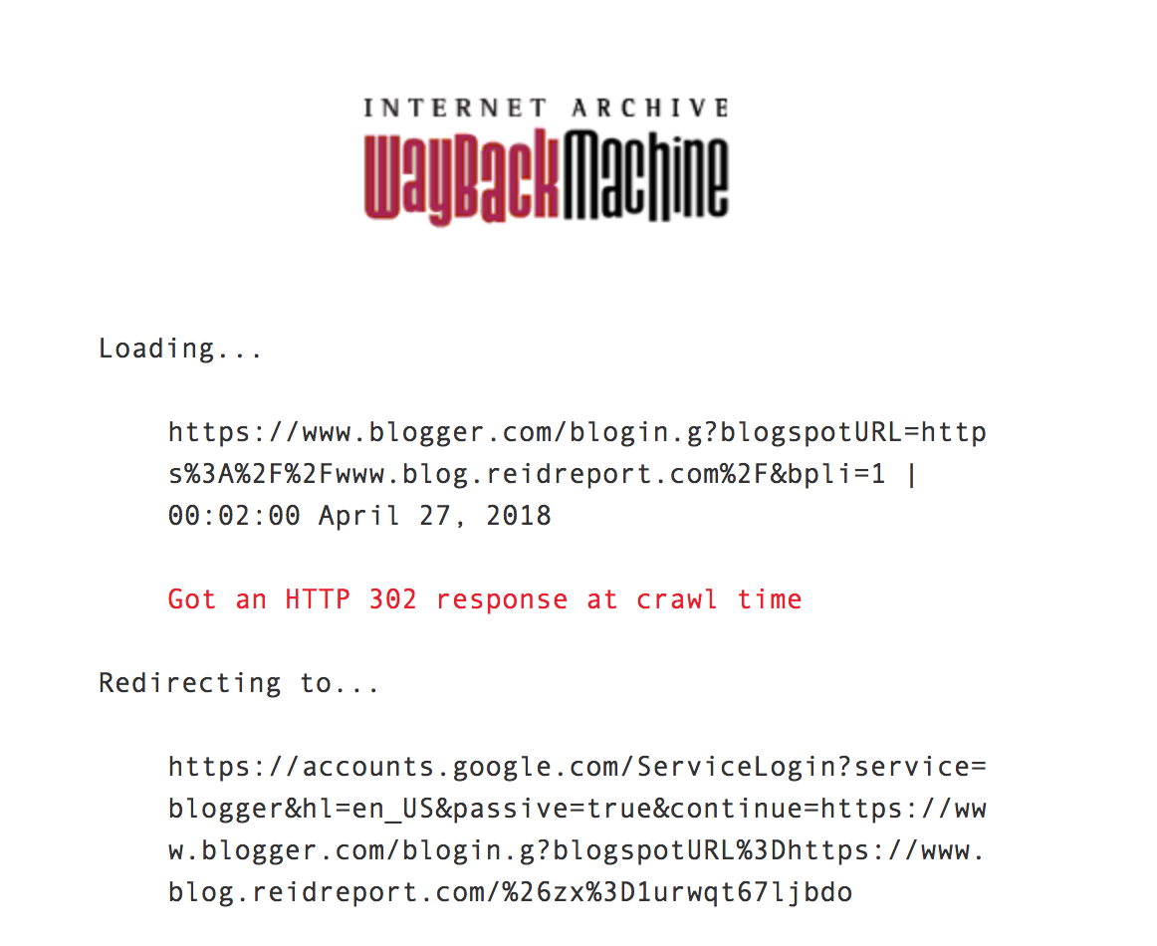
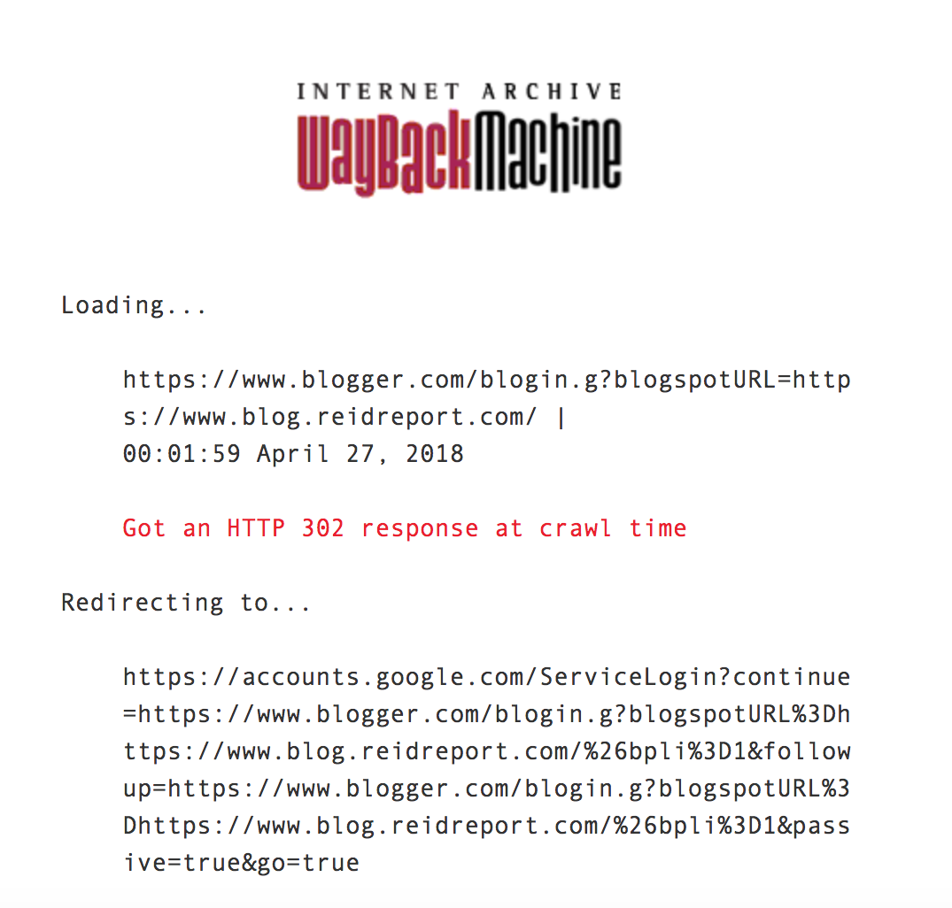
Redirections...

Slide 33
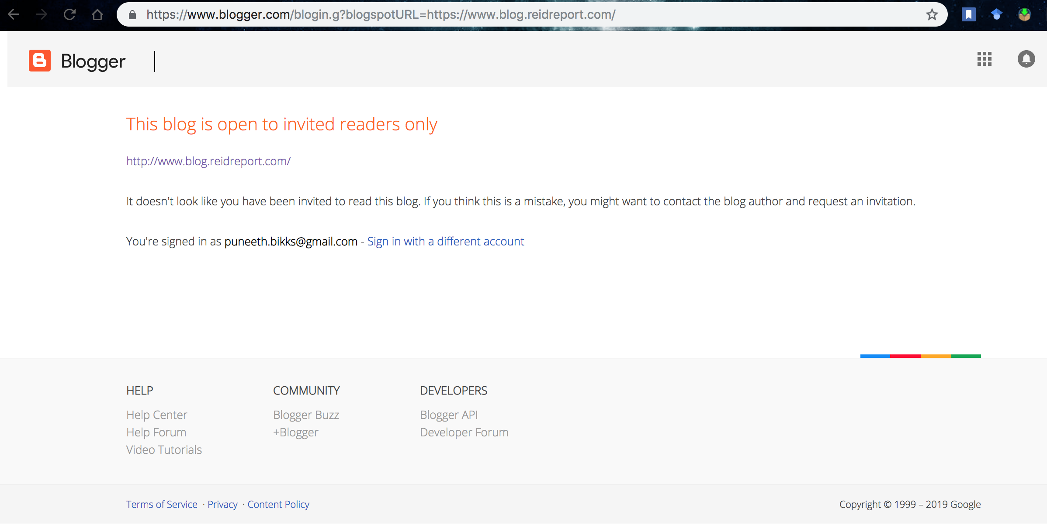
The blog now needs an invitation!

Slide 34
Conclusion:
As archived web is sometimes unreliable, it is better to have multiple archiving platforms.
Resource not found in one platform can be sought from rest of the archives.
Multiple web archiving platforms needs to be universally accessible and aid others creating backup copies (as found on wayback machine), so it can be the evidence for the scenarios similar to Reid’s case.
Records on the archives must remain accessible, long after the service is stopped.
https://www.slideshare.net/phonedude/we-need-multiple-independent-web-archives

